Slide 1
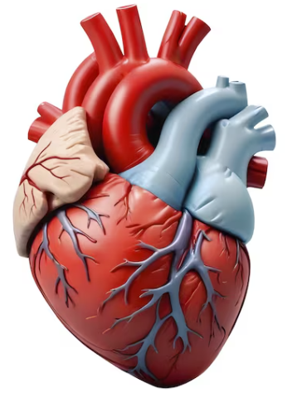
Analyzing report
Predicting Cardiovascular Disease

Slide 2
Name: Huzaifa Baig
Dataset : Predicting Cardiovascular Disease
Assigned by : Sir Yasir Nawaz

Slide 3
Introduction
This heart disease dataset is common features which makes it one of the heart disease dataset available so far for research purposes.
This dataset consists of 1000 subjects with 14 features.
This dataset will be useful for building an early-stage heart disease detection as well as to generate predictive machine learning models.

Slide 4
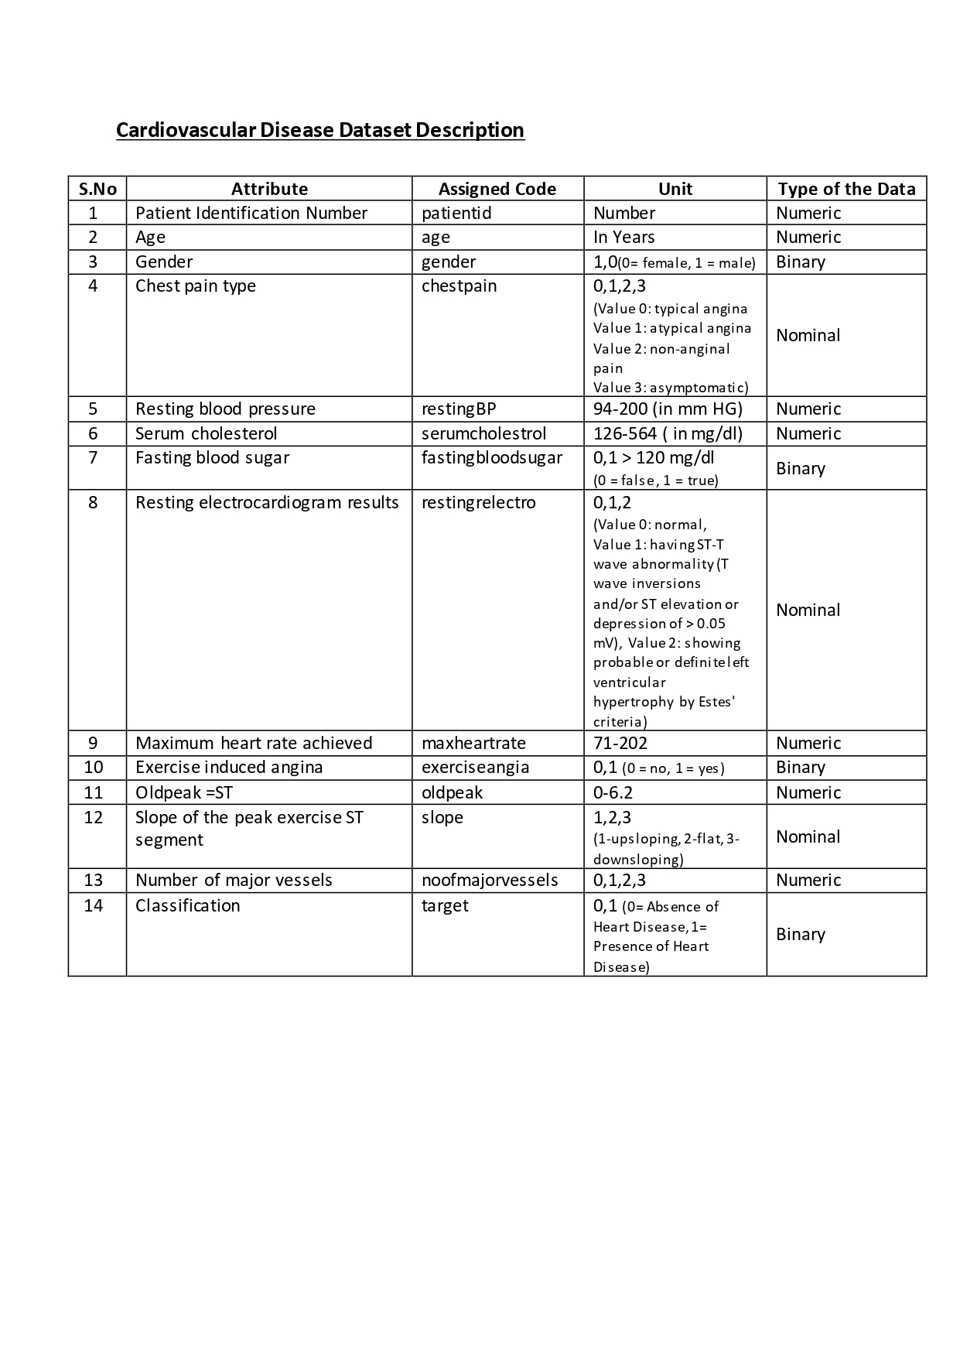
Cardiovascular Disease Dataset Description

Slide 5
Cardiovascular Disease Dataset Description

Slide 6
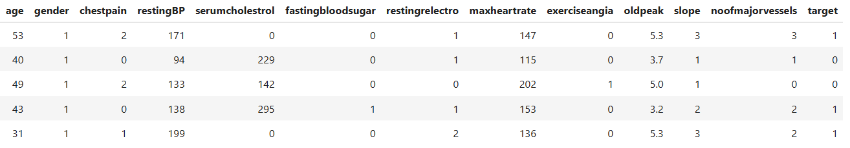
Cardiovascular Disease Actual Dataset

Slide 7
Exploratory Data Analysis
(EDA)
Exploratory Data Analysis (EDA) is an analytical approach to understand a dataset's main characteristics by summarizing and visualizing it, primarily using statistical graphics and data visualization methods to uncover patterns, anomalies, and relationships.

Slide 8
# | Columns | Non-Null | Count | Dtype
1 | patientid | 1000 | non-null | int64
2 | age | 1000 | non-null | int64
3 | gender | 1000 | non-null | int64
4 | chestpain | 1000 | non-null | int64
5 | restingBP | 1000 | non-null | int64
6 | serumcholestrol | 1000 | non-null | int64
7 | fastingbloodsugar | 1000 | non-null | int64
8 | restingrelectro | 1000 | non-null | int64
9 | maxheartrate | 1000 | non-null | int64
10 | exerciseangia | 1000 | non-null | int64
11 | oldpeak | 1000 | non-null | float64
12 | slope | 1000 | non-null | int64
13 | noofmajorvessels | 1000 | non-null | int64
14 | target | 1000 | non-null | int64
dtypes: float64(1), int64(13)

Slide 9
Columns | 'patientid', 'age', 'gender', 'chestpain', 'restingBP', 'serumcholestrol', 'fastingbloodsugar', 'restingrelectro', 'maxheartrate', 'exerciseangia', 'oldpeak', 'slope', 'noofmajorvessels', 'target'
Shape | (1000, 14)
Duplicated | 0
Null | 0

Slide 10
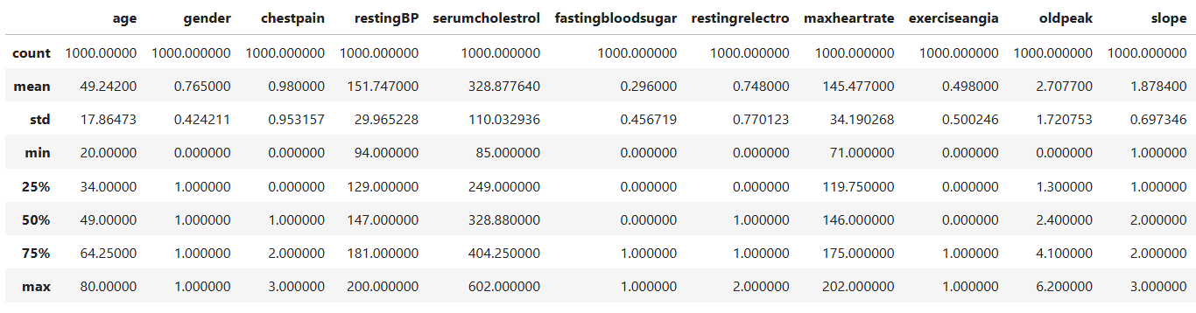
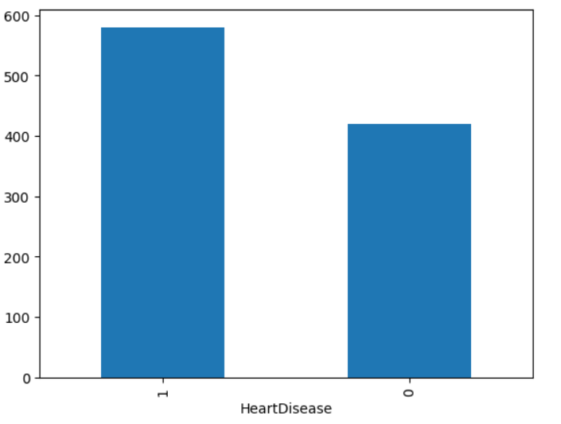

Slide 11
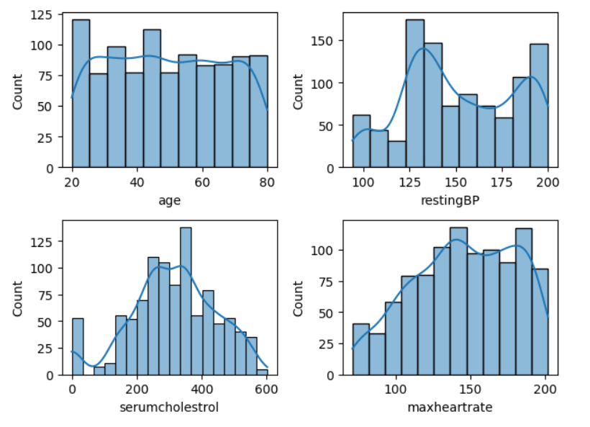

Slide 12
Data cleaning
Data cleaning, or data cleansing, in machine learning is the process of identifying and rectifying errors, inconsistencies, and inaccuracies within a dataset to improve its quality, reliability, and suitability for training machine learning models. This crucial preprocessing step ensures that the data is accurate, consistent, and free of issues that could negatively impact model performance and lead to unreliable predictions.

Slide 13
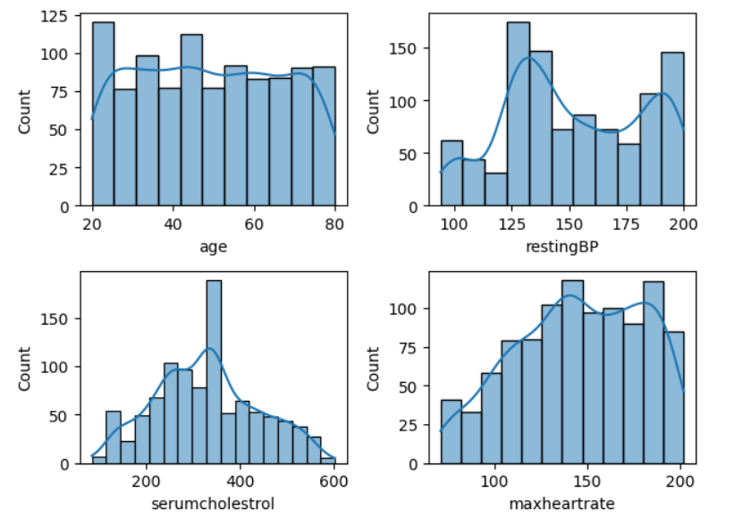

Slide 14
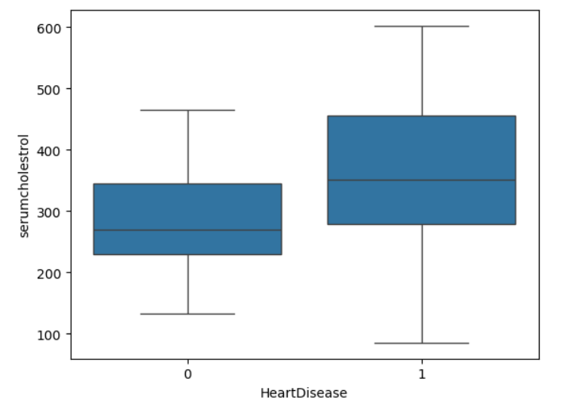

Slide 15
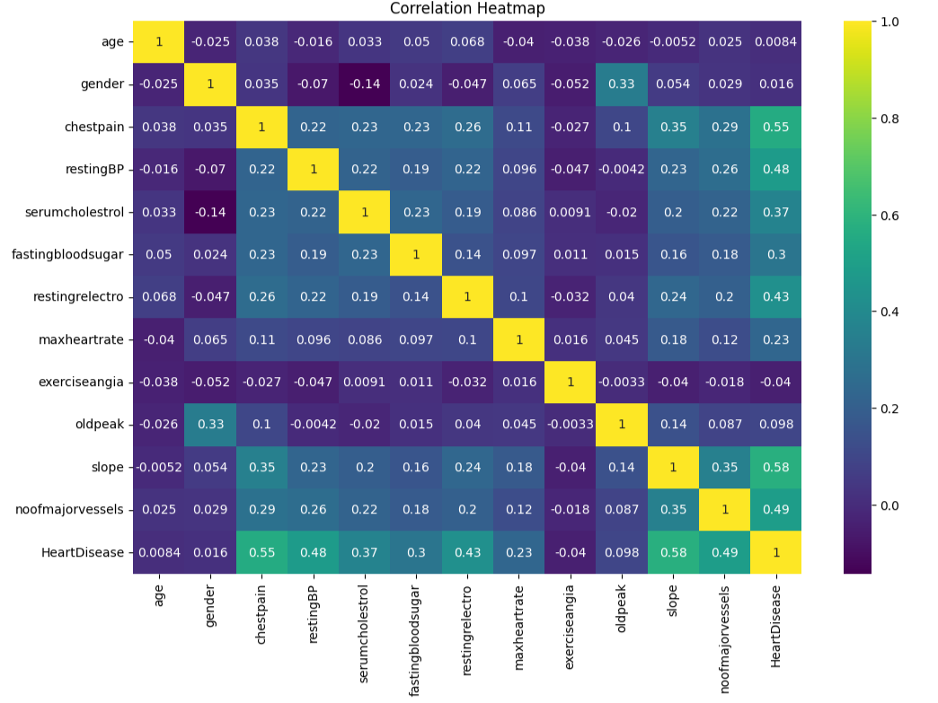

Slide 16
Apply Machine Learning Algorithm
Logistic Regression

Slide 17
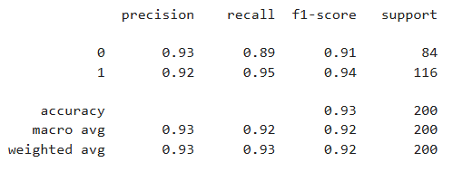
Training accuracy: 92.62
Testing accuracy: 92.50
Classification Report.

Slide 18
Application Interface

Slide 19
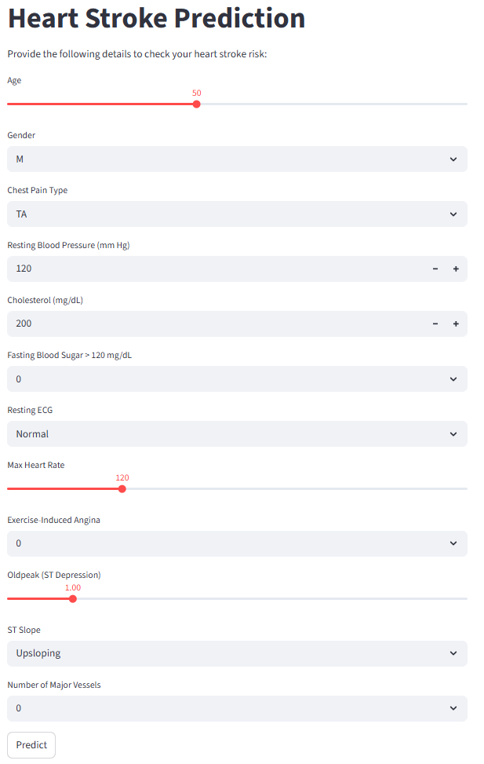

Slide 20
Tnank you

